Slide 1


2021
1/19
EduCorpus & AraScore Dataset:Under-resourced languages in the Educational Domain
01
By: Dina Tarek ElSakaty
Supervised by: Dr. Nada Sharaf
Date: 8th of August, 2021
Notes:
Good morning everyone, first of all I would like to introduce myself, I am Dina Tarek a fourth year computer engineering student at the GUC and today I would be privileged to present to you my bachelor project with the title of xxx in which I was honored to implement it under the supervision of Dr Nada Sharaf.

Slide 2
2021 EDUCORPUS & ARASCORE DATASET:UNDER-RESOURCED LANGUAGES INTHE EDUCATIONAL DOMAIN
2/19
Outline
Introduction
Background
Methodology
Experimental Results
Conclusion and Future Work
References
02
Notes:
First things first, I would very much like to kick it off by walking you through the outline of today's presentation. The outline will include the following topics respectively, introduction, background, methodology, experimental results, conclusion and future work and finally references.

Slide 3
2021 EDUCORPUS & ARASCORE DATASET:UNDER-RESOURCED LANGUAGES INTHE EDUCATIONAL DOMAIN
3/19
Motivation:
The task of automated essay scoring has a lot of academic and commercial values and challenges.
Introduction
03
Aim of the Project:
Explore different techniques for augmenting arabic datasets.
Experiment those techniques on automated essay scoring task.
Notes:
Formally, the auto grading short answer question is defined as grading the question in context of the student’s response and their baseline response.
As NLP relies heavily on training data, label-preserving data augmentation techniques are known to help methods generalize better by increasing the variance of training data.
In this presentation, different techniques for augmenting arabic datasets will be explored and experiment it on the task of automated essay scoring.

Slide 4
2021 EDUCORPUS & ARASCORE DATASET:UNDER-RESOURCED LANGUAGES INTHE EDUCATIONAL DOMAIN
4/19
Machine Learning
Machine learning is a branch of artificial intelligence which focuses on the use of data and algorithms to imitate the way that humans learn, gradually improving its accuracy.
Background
Decision Process
Error Function
Model Optimization
04
Deep Learning
Deep learning automates most of the feature extraction from the process, eliminates some of the required manual intervention and allows the use of larger datasets.
Notes:
Machine Learning algorithms work in a three processes manner:
Process 1 is the decision process where machine learning algorithms are used to make a prediction and based on some input which can be labelled or unlabelled, the algorithm will produce an estimate about a pattern in the data.
Process 2 is the error function where it serves to evaluate the prediction of the model
Process 3 is the model optimization process where the algorithm will repeat the evaluating and optimizing processes to see if the model can fit better to the data points in the training set until a threshold of accuracy has been met.
Since deep learning and machine learning are often used interchangeably, the subtle difference between the two is worth noting. The difference between deep learning and machine learning lies in the learning method of each algorithm.
Deep learning automates most of the feature extraction from the process, eliminates some of the required manual intervention and allows the use of larger datasets while machine learning relies more on human intervention to learn.

Slide 5
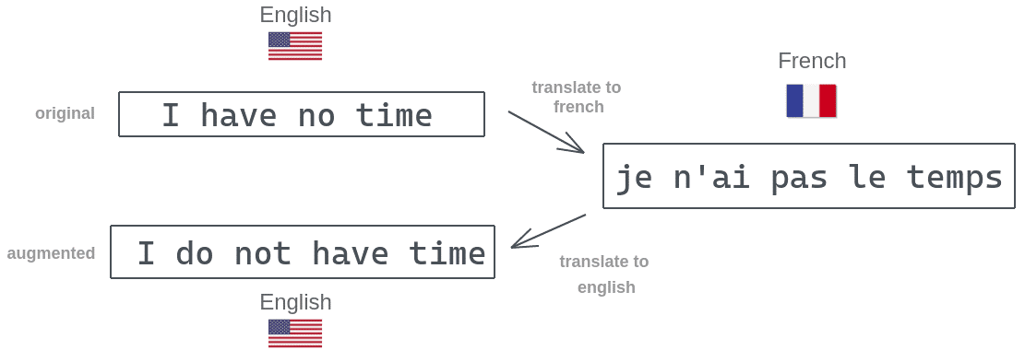
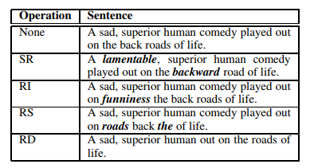
2021 EDUCORPUS & ARASCORE DATASET:UNDER-RESOURCED LANGUAGES INTHE EDUCATIONAL DOMAIN
5/19
Data Augmentation
A technique used to increase the amount of data by adding slightly modified copies of already existing data or newly created synthetic data from existing data.
Contextual Word Embedding
Text Generation
Background
05
Notes:
This could be done with any form of data from numbers to images, because the more data we have the better performance we can achieve.
In the field of natural language processing, it is difficult to expand text because of the high complexity of the language, changing a word could result in a totally different context.
Natural language processing tasks can use different augmentation techniques such as back translation as demonstrated in the first figure shown. The sentence “I have no time” in English could be translated to French then back to English “I do not have time” which results in a new sentence. Other techniques could be Synonym replacement, Random insertion, Random swap, Random deletion as shown in the figure below, or by contextual word embedding or text generation.

Slide 6
2021 EDUCORPUS & ARASCORE DATASET:UNDER-RESOURCED LANGUAGES INTHE EDUCATIONAL DOMAIN
6/19
Text Generation
Text Generation is a subfield of natural language processing.
It automatically generates natural language texts.
Greedy Search
Top-k Sampling
Background
06
Notes:
Text generation is a subfield of natural language processing which laverages knowledge in computational linguistics and artificial intelligence to automatically generate natural language texts.
To build a good text generation model, some steps should be taken into consideration such as applying good guided decoding strategies and selecting the output required.
Some common decoding strategies could be greedy search or top k sampling.
Greedy Search always picks the next token with the highest probability but it tends to create repetitions of phrases even for well trained models.
Top k sampling works as follows, at each sampling step, only the top k most likely tokens are selected and the probability mass is redistributed among them. This approach generates less repetitive content.
This GIF illustrates how text generation works, you just type some words and it automatically generates text in the context of the inserted text.

Slide 7
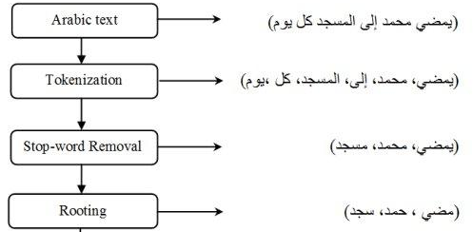
2021 EDUCORPUS & ARASCORE DATASET:UNDER-RESOURCED LANGUAGES INTHE EDUCATIONAL DOMAIN
7/19
Data Preprocessing
A data mining technique that involves transforming raw data into an understandable format.
Data cleaning
Background
07
Notes:
It’s a core natural language processing task.
The first step involves data cleaning then some other steps are applied such as tokenization, stop word removal and rooting.
Tokenization is the process of breaking down the given text into the smallest unit in a sentence called a token.
The purpose of tokenization is to detect and isolate the individual words by removing additional components such as white spaces, punctuation marks and any other special characters.
Rooting is the process of finding the root of words by eliminating the suffixes and prefixes.

Slide 8
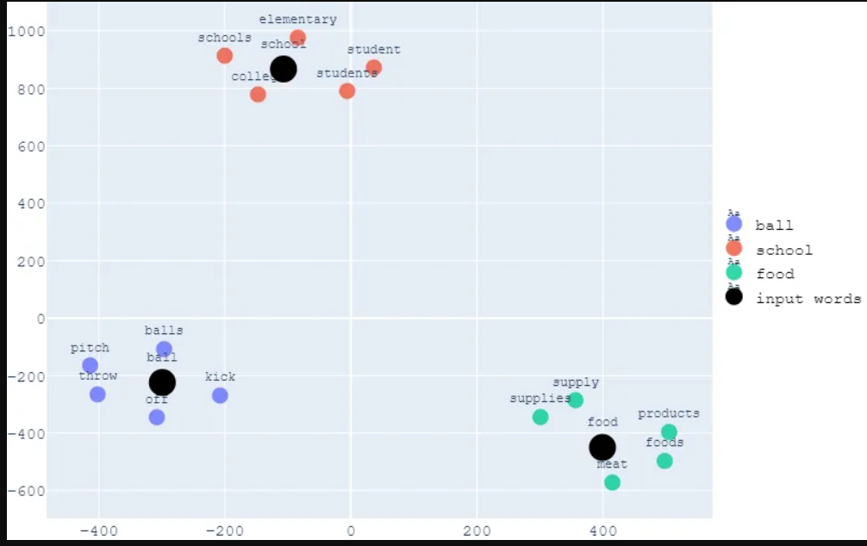
2021 EDUCORPUS & ARASCORE DATASET:UNDER-RESOURCED LANGUAGES INTHE EDUCATIONAL DOMAIN
8/19
Word Embedding
A learned representation for text where words that have the same meaning have a similar representation in vector space.
Background
08
Notes:
By translating a word to an embedding it becomes possible to model the semantic importance of a word in a numeric form and thus perform mathematical operations on it.
To make this clear, the figure shown illustrates how word embedding work.
As you can see words related to school such as elementary, students and college are grouped near each other with similar representations as they have similar meanings.

Slide 9
2021 EDUCORPUS & ARASCORE DATASET:UNDER-RESOURCED LANGUAGES INTHE EDUCATIONAL DOMAIN
9/19
Language Models
A probability distribution over words or word sequences.
Bidirectional Encoder Representations from Transformers: transformer based machine learning technique developed by Google. It makes use of transformer, a mechanism that learns contextual relations between words in a text.
Generative Pre-trained Transformer: displays a wide range of features including the ability to generate conditional synthetic text samples.
Background
09
Notes:
In practice, a language model gives the probability of a certain word sequence being valid in terms of similarity between the way people write, which is what the language model learns. BERT
BERT’s key technical innovation is applying the bidirectional training of a transformer.
This is in contrast to previous work where previous work looked at a text sequence either from left to right or from right to left which is proven that a language model which is bidirectionally trained can have a deeper sense of language context and flow than single direction language models.
BERT makes use of Transformer, an attention mechanism that learns contextual relations between words in a text.
Transformers include two independent mechanisms, an encoder that reads the text input which allows the model to learn the context of a word based on all the of its surroundings and a decoder that produces a prediction for the task.
GPT / But they have two main limitations, they need a large amount of annotated data to learn specific tasks and they can not generalize tasks other than those they were trained on.

Slide 10
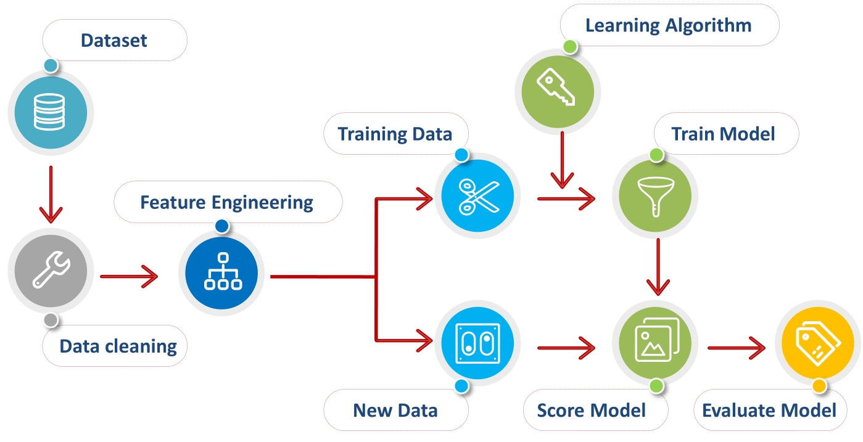
2021 EDUCORPUS & ARASCORE DATASET:UNDER-RESOURCED LANGUAGES INTHE EDUCATIONAL DOMAIN
10/19
Pipeline
Methodology
10
Feature extraction: iterating through each data example to extract features using a frequency dictionary and finally creating a feature matrix.
Notes:
On to the methodology part, since every machine learning task should have a pipeline, the figure shown illustrates the pipeline we followed. The dataset used has 5 columns which are ID, EssaySet, Score1,Score2 and EssayText.
First we cleaned our dataset by removing unwanted texts from the EssayText column such as stop words and punctuation that do not have any sentimental value then we applied feature extraction where we kept on iterating through each data example to extract features using a frequency dictionary and finally creating a feature matrix , then we’ll split the dataset into training and testing datasets using 80-20 approach.
Now on to the training stage using the feature matrix in order to use that model for predicting scores in Score1 column. Finally, testing the model using the trained one to get the predictions from data it never saw.

Slide 11
2021 EDUCORPUS & ARASCORE DATASET:UNDER-RESOURCED LANGUAGES INTHE EDUCATIONAL DOMAIN
11/19
Data Cleaning
The process of detecting inaccurate records from a table then modify or replace it.
Remove diacritics
Remove repeating characters
Dropping NaN values
Methodology
11
Notes:
Data cleaning is the process of detecting and correcting inaccurate records from a table and refers to identifying incomplete, incorrect, inaccurate or irrelevant parts of the data and then replacing, modifying, or deleting the dirty or coarse data. This could be done by dropping NaN values, removing diacritics and repeating characters.

Slide 12
2021 EDUCORPUS & ARASCORE DATASET:UNDER-RESOURCED LANGUAGES INTHE EDUCATIONAL DOMAIN
12/19
Easy Data Augmentation
Feature Extraction
Augmentation Techniques
Word2Vec
Dataset Size
Methodology
12
Notes:
The first method used for augmenting our dataset is easy data augmentation which basically involves two techniques which are synonym replacement and back translation.
Before augmenting our dataset, words in EssayText column need to be encoded as integers or floating point values to use as input to a machine learning model algorithm, which is known by feature extraction.
Next, we will convert text to word frequency vectors using TfidfVectorizer, which basically means Term Frequency-Inverse Document Frequency.
Term Frequency summarizes how often a given word appears in the EssayText column while Inverse Document Frequency downscales words that appear a lot across the column.
Moving to the augmentation techniques used, in synonym replacement we randomly choose n words from a sequence in the EssayText column and replace each of these words with one of its synonyms using a method called most similar in word2vec. Word2vec’s main purpose is to group the vectors of similar words in vector space. while in back translation we randomly choose a language from the available languages list and translate it to this chosen language then translate it back to Arabic. Initially, the dataset size was 17008 rows of data. After augmenting, a new column called EssaytextAugmented was added that contains an array of the augmented texts corresponding to each text in the EssayText column.

Slide 13
2021 EDUCORPUS & ARASCORE DATASET:UNDER-RESOURCED LANGUAGES INTHE EDUCATIONAL DOMAIN
13/19
Text Generation
Word Mappings
Sampling
Fine-Tuning AraGPT-2
AraGPT-2 Tokenizer allows adding new tokens
Generate from the Model
Methodology
13
Notes:
The second method for augmenting our dataset is by using text generation using AraGPT, which is basically the same as GPT but for Arabic. One issue with text generation is the lack of control in the direction it takes. To overcome this problem, we use word mappings. Word mappings is a step where we assign an arbitrary number to a word in the text. In this way, all unique words are mapped to a number. We first train the language model on our dataset which learns the statistical distributions of the next token for a given token sequence from the dataset. Now comes the sampling part which means randomly picking the next word according to its statistical probability distribution. To select the next token, we used the top-k sampling approach. To generate text similar to the context of our dataset, we need to finetune our model. The pipeline setup involves defining our model, the tokenizer and the dataset which was split into three sets(train, evaluation, test) randomly. The AraGPT tokenizer allows adding new tokens to the vocabulary in a way that is independent of the underlying structure. We added four tokens for our four score values which are 0,1,2 and 3 to generate texts according to each score value. Finally, now we can generate text by passing the first word in the EssayText column along with its score1 value to generate text accordingly. It was clear how the score affects the meaning of the generated text.

Slide 14
2021 EDUCORPUS & ARASCORE DATASET:UNDER-RESOURCED LANGUAGES INTHE EDUCATIONAL DOMAIN
14/19
Masked Token Prediction
MLM is a fill-in-the-blank task.
Loading and Splitting our Dataset
Fine-Tuning AraBERT
AraBERT Tokenizer allows adding special tokens, pad and truncate sequences to a single constant length.
Model Training
Methodology
14
Notes:
The third and last method used for augmenting our dataset was by using Masked token prediction using AraBERT which is exactly as BERT but for Arabic. Masked Language Modeling is a fill in the blank task where a model uses the context words surrounding a mask token to try to predict what the masked word should be. Approximately 15% of the words are masked while training but not all of the masked words are replaced by the mask token. 80% of the time with mask token10% of the time with random tokens and another 10% with the unchanged input tokens that were being masked. The dataset was split into three sets, train, validation and test. Next, we started finetuning the model using the train and validation sets and make predictions for the test set. The pipeline followed was importing AraBERT model and tokenizer then model finetuning. AraBERT tokenizer allows adding special tokens to the start and end of each sentence, pad and truncate all sentences to a single constant length. This could be done by the encode_plus method of the tokenizer which split the text into tokens, add the special tokens, convert theee tokens into indexes of the tokenizer vocabulary as well as pad and truncate sentences to maximum length. Next step is to train the model on 10 epochs, in each epoch, the model was evaluated on the validation set. In the training phase the model predicts the masked tokens while in the evaluating phase the validation loss and accuracy are computed between the actual and predicted values over the validation set. The validation loss indicates how well the model fits new data.

Slide 15
2021 EDUCORPUS & ARASCORE DATASET:UNDER-RESOURCED LANGUAGES INTHE EDUCATIONAL DOMAIN
15/19
Evaluation Metrics Used
Accuracy
Quadratic Weighted Kappa(QWK)
Perplexity
Results
15
Classifier Used
Random Forest Classifier
Notes:
QWK is a measure of agreement between the scores which are predicted and the known scores. Perplexity is measurement of how well a probability model predicts a sample. Random forests creates decision trees on randomly selected data samples, gets prediction from each tree and selects the best solution by means of voting.

Slide 16
2021 EDUCORPUS & ARASCORE DATASET:UNDER-RESOURCED LANGUAGES INTHE EDUCATIONAL DOMAIN
16/19
Method used
Accuracy(%)
QWK
Perplexity
No Augmentation
68
0.59
-
Results
EDA
70
0.62
-
16
Text Generation
-
-
6.819
Token Prediction
77
-
-
Notes:
The results were reported as shown in the table.

Slide 17
2021 EDUCORPUS & ARASCORE DATASET:UNDER-RESOURCED LANGUAGES INTHE EDUCATIONAL DOMAIN
17/19
Conclusion
Data Augmentation enhance performance
Using language models could be challenging but more efficient.
Conclusion and Future Work
17
Future Work
Try these techniques for different tasks and different related data.
Notes:
In conclusion, after applying all the augmentation methods mentioned earlier, it is proven that data augmentation enhance the model’s performance especially by using language models such AraBERT and AraGPT-2 that come with its challenges.
Future work could be trying these techniques for different tasks and different related data.

Slide 18
2021 EDUCORPUS & ARASCORE DATASET:UNDER-RESOURCED LANGUAGES INTHE EDUCATIONAL DOMAIN
18/19
W. Antoun. AraBERT: Transformer-based Model for Arabic Language Understanding. Proceedings of the 4th Workshop on Open-Source Arabic Corpora and Processing Tools, 2020.
W. Antoun. ARAGPT2: Pre-Trained Transformer for Arabic Language Generation. arXivLabs, 2021.
J. Devlin. BERT: Pre-training of Deep Bidirectional Transformers for Language Understanding . Association for Computational Linguistics,2019.
V. Marivate. Improving short text classification through global augmentation methods. arXivLabs, 2020.
J. Wei. EDA: Easy Data Augmentation Techniques for Boosting Performance on Text Classification Tasks. arXivLabs, 2019.
V. Kumar. Data Augmentation Using Pre-trained Transformer Models.arXivLabs, 2021.
References
18
Notes:
Here are some references that helped me in implementing the project.

Slide 19
2021 EDUCORPUS & ARASCORE DATASET:UNDER-RESOURCED LANGUAGES INTHE EDUCATIONAL DOMAIN
19/19
Thank you!
ANY QUESTIONS?
Notes:
Thank you very much for your attention

